Slide 1
Movie review website
21cs3009
Banala Raghavendra

Slide 2
Introduction to website
This website contains deep information about the latest and evergreen movies in majority spoken languages ,also mentions which type of movie.
It gives the honest review of the movie and puts if there are any key scenes and makes sures there are no spoilers mentioned so that audience experience the thrill.
This website mainly takes review from the viewers and also mentions the rating of each movie accordingly. It clearly explains the cast , crew to make audience anxious.

Slide 3
Categorization 1.0
MOVIE REVIEW WEBSITE contains movies from almost all over India in Hindi
Telugu
English
Tamil
Malayalam
Kannada
Marathi and more…
Movies available in many languages will also be mentioned.

Slide 4
Categorization 2.0
It contains the movie types like
Action
Adventure
Love
Fiction
Thriller or Horror
Drama
and there are mentioned in every category wise and mixed feelings are mentioned in the review of the movie.

Slide 5

Every movie having review in the website will have the review with the releasing poster of the movie.
TITANIC

Slide 6
Main characters and cast will be mentioned.
Director of the movie will be mentioned as far as the movie have high audience and hit the box office collection.

Slide 7

The viewer of the website gets the opportunity to like the movie review they watch and it is completely trusted.
They can like with the text “like” and one thumbs up symbol is mentioned just side to it. The number of likes will be displayed as well.

Slide 8

Release date of the movie is mentioned below the movie poster.

Slide 9
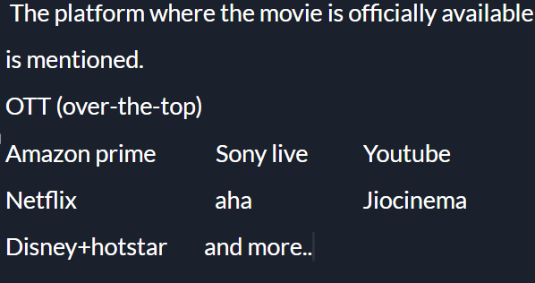

Slide 10
Search option is also displayed to search the movies they want with a search bar on the top.
Movies with particular categories are also displayed upon viewer search.

Slide 11

Rating of the movie is mentioned with the limit of 5 stars.
The website thus suggests the better movies in a particular domain (say action movies)
In recent times “Top GUN Maverick” movie is
suggested.

Slide 12
Finally, the viewer also gets the opportunity to rate the website to let know whether the website is useful or not to update the website as the users (audience) suggests.
This rating is concerned upto 5 stars.

Slide 13
Conclusion
Viewers can see the review, like the movie review and also see the rating of the movies also gets opportunity to rate the website as well.

